Slide 1
Heart Disease Prediction Using Machine Learning
Project under the supervision of
Prof. M H khan
Dr. Promila Bahadur
Submitted by :
Arjun Singh
Gaurav Kumar
Sanjay Singh

Slide 2
Introduction
According to the World Health Organization, every year 12 million deaths occur worldwide due to Heart Disease.
The early diagnosis of heart disease plays a vital role in making decisions on lifestyle changes in high-risk patients and in turn reduces the complications.
Machine learning proves to be effective in assisting in making decisions and predictions from the large quantity of data produced by the health care industry.
This project aims to predict future Heart Disease by analyzing data of patients which classifies whether they have heart disease or not using machine-learning algorithm
By collecting the data from various sources, classifying them under suitable headings & finally analysing the data and giving the result.

Slide 3
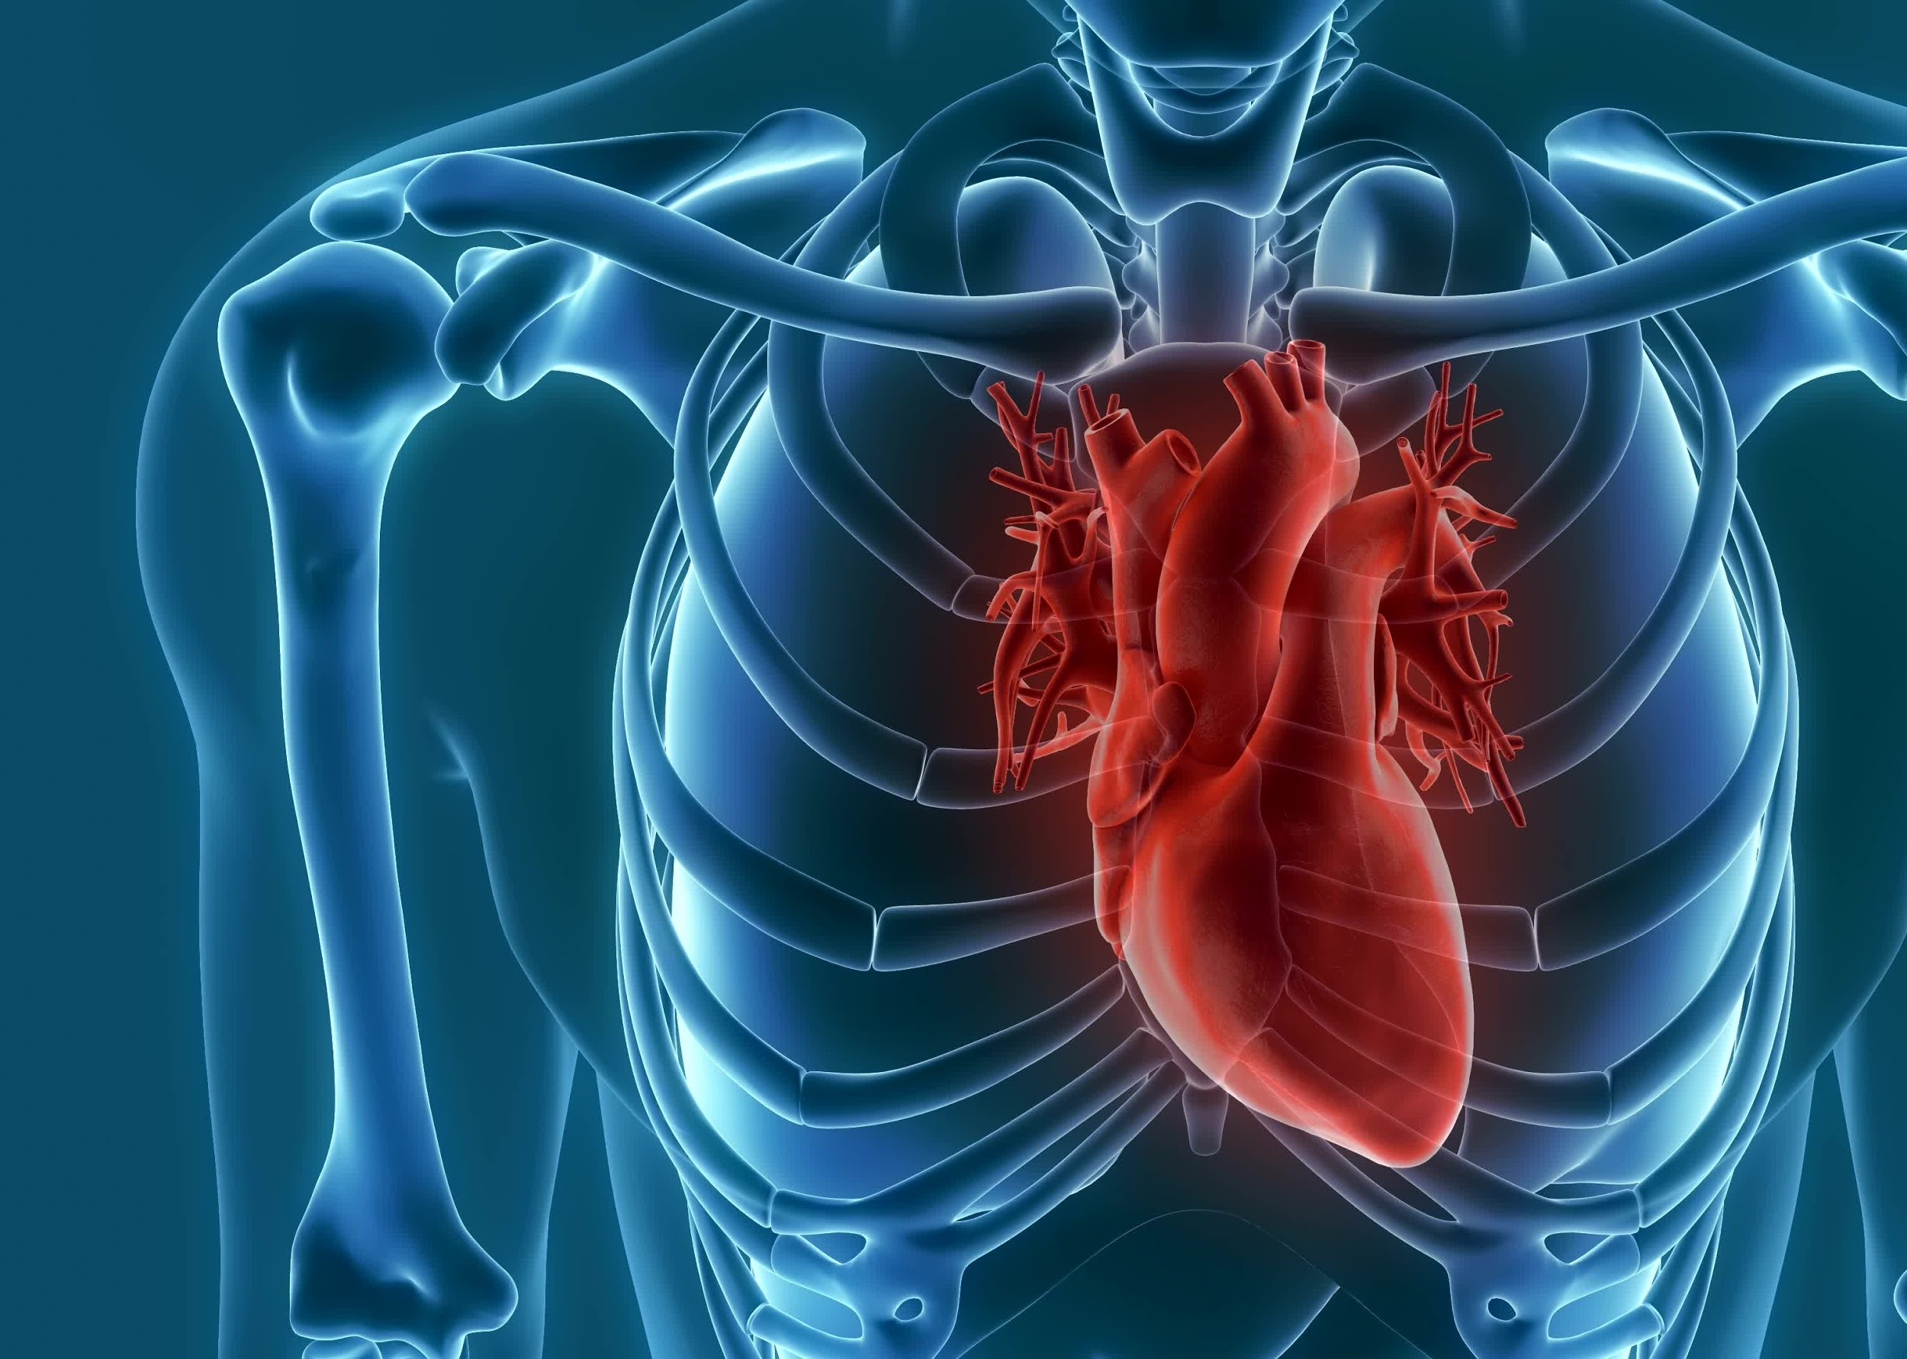
The Working of the Project

Slide 4
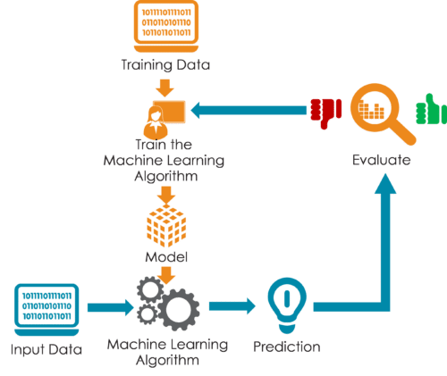

Slide 5
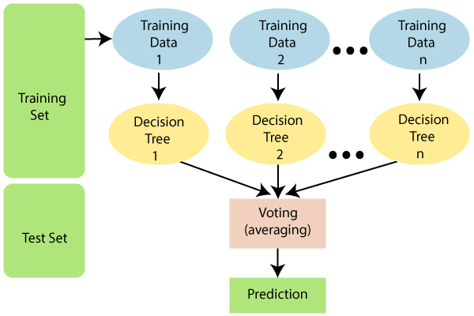
Algorithm Used
Random Forest
Random Forest is a classifier that contains a number of decision trees on various subsets of the given dataset and takes the average to improve the predictive accuracy of that dataset.

Slide 6

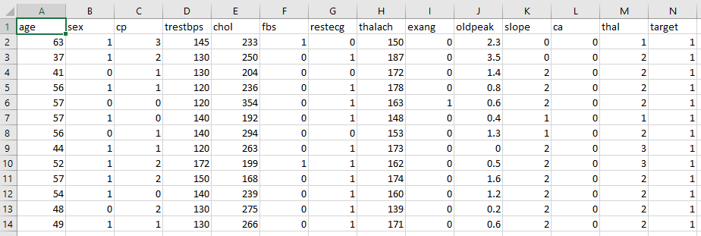
Dataset
Cp->Chest pain, trestbps->resting blood pressure, chol->serum cholestoral,
fbs-> blood sugar, restecg->electrocardiographic, thalach->maximum heart rate
exang-> angina, ca->major vessels fluoroscopy
Cp- Chest Pain, Trestbps- resting blood pressure, chol- serum cholesterol
Fbs- Blood Sugar, restecg- electrocardiography, thalach- maximum heart rate
Exang- angina, ca- major vessel fluoroscopy
We implemented two more datasets for better prediction:
- Smoker
- Genetic Hereditary

Slide 7
Dataset Attributes
Gender (value 1: Male; value 0 : Female)
Chest Pain Type (value 1: typical type 1 angina, value 2: typical type angina, value 3: non-angina pain; value 4: asymptomatic)
Fasting Blood Sugar (value 1: > 120 mg/dl; value 0:< 120 mg/dl)
Exang – exercise induced angina (value 1: yes; value 0: no)
CA – number of major vessels colored by fluoroscopy (value 0 – 3)
Thal (value 3: normal; value 6: fixed defect; value 7:reversible defect)
Trest Blood Pressure (mm Hg on admission to the hospital)
Serum Cholesterol (mg/dl)
Thalach – maximum heart rate achieved
Age in Year
Height in cms
Weight in Kgs.
Cholestrol
Rest ecg

Slide 8
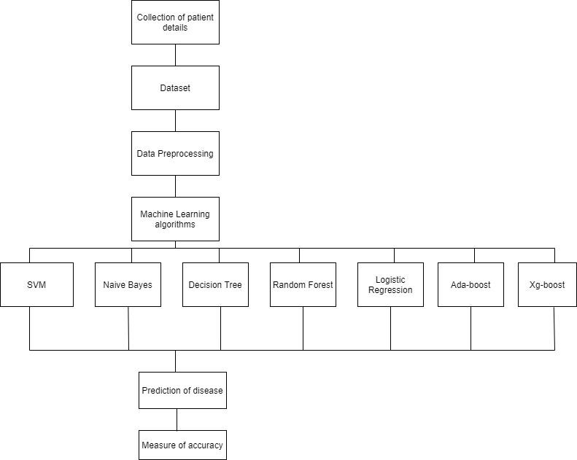
Step wise process

Slide 9
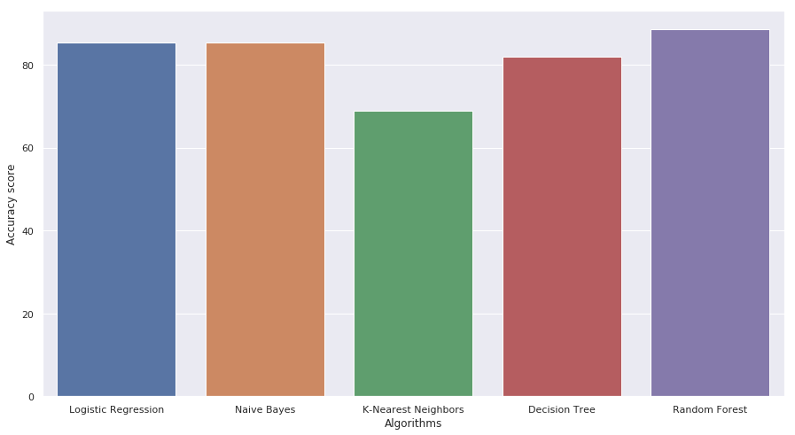
Comparison of Different ML Algorithms
81.9%
88.52%
68%
85.24%
85.24%

Slide 10
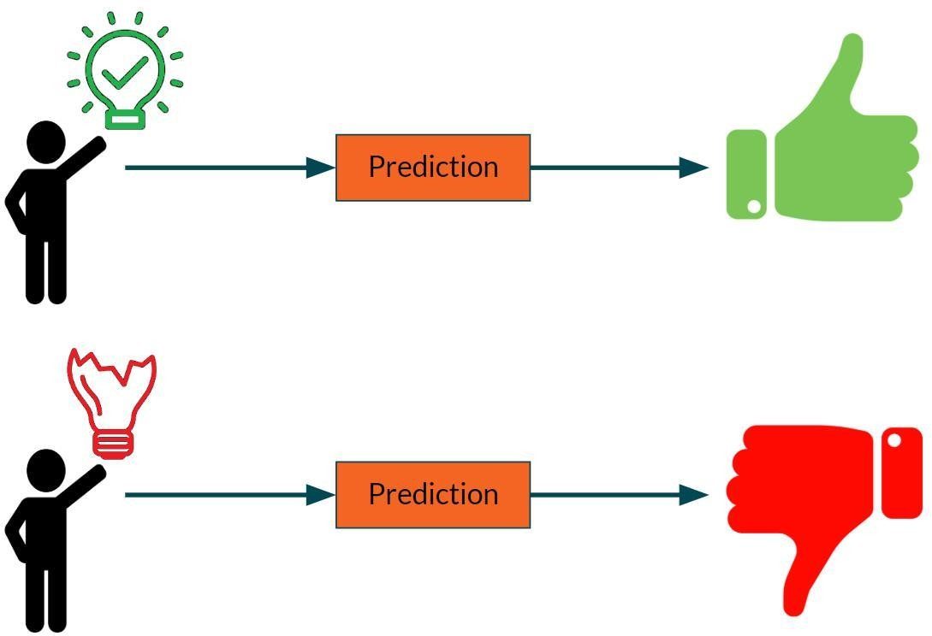
Prediction of Disease
If the details from the user fall under the good condition of heart then it gives the positive output,
And if it doesn’t then it recommends to consult the doctor.

Slide 11
Correlation Matrix
The correlation matrix in machine learning is used for feature selection. It represents dependency between various attributes.
Precision- It is the ratio of correct positive results to the total number of positive results predicted by the system.
Recall- It is the ratio of correct positive results to the total number of negative results predicted by the system
F1 Score- It is the harmonic mean of Precision and Recall. It measures the test accuracy. The range of this metric is 0 to 1.

Slide 12
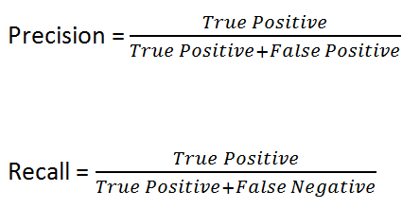
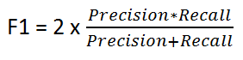

Slide 13
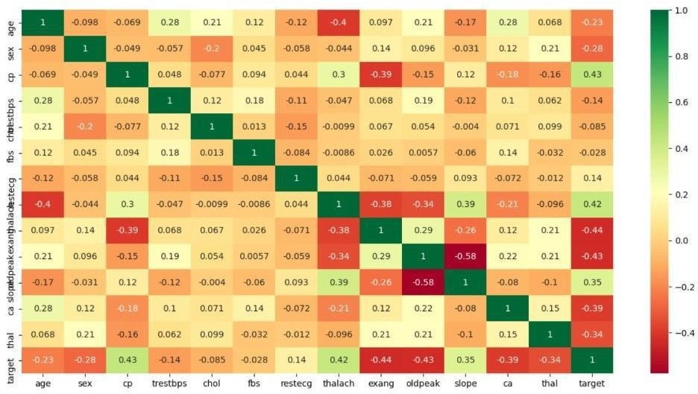
Correlation matrix

Slide 14

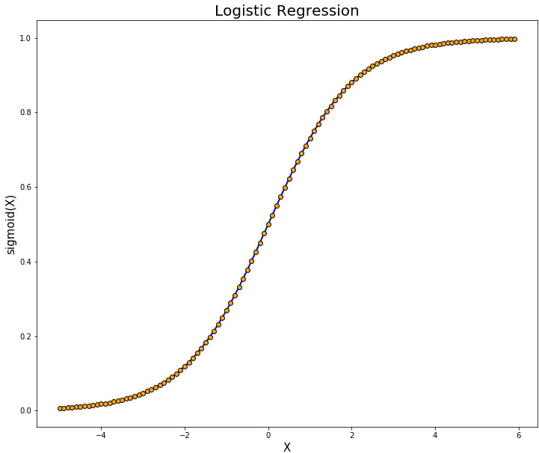
Logistic Regression
Logistic regression is one of the most popular Machine Learning algorithms, which comes under the Supervised Learning technique. It is used for predicting the categorical dependent variable using a given set of independent variables.
Logistic regression predicts the output of a categorical dependent variable. Therefore the outcome must be a categorical or discrete value. It can be either Yes or No, 0 or 1, true or False, etc. but instead of giving the exact value as 0 and 1, it gives the probabilistic values which lie between 0 and 1

Slide 15
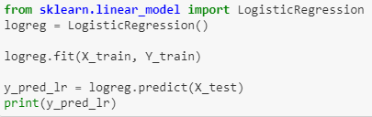
Logistic Regression Implementation

Slide 16
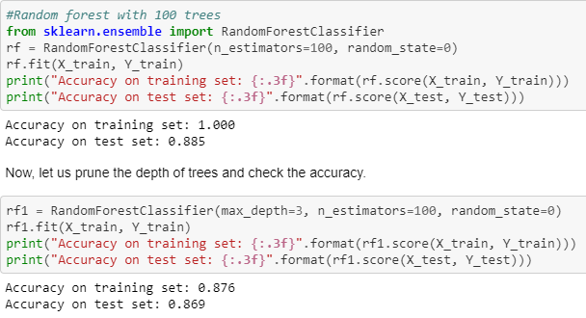
Random Forest Implementation

Slide 17
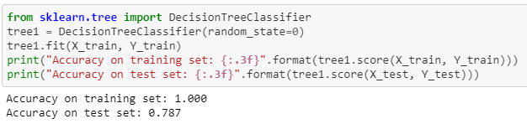
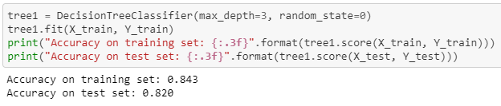
What is decision tree ?
A decision tree is a flowchart-like structure in which each internal node represents a test on a feature , each leaf node represents a class label and branches represent conjunctions of features that lead to those class.

Slide 18
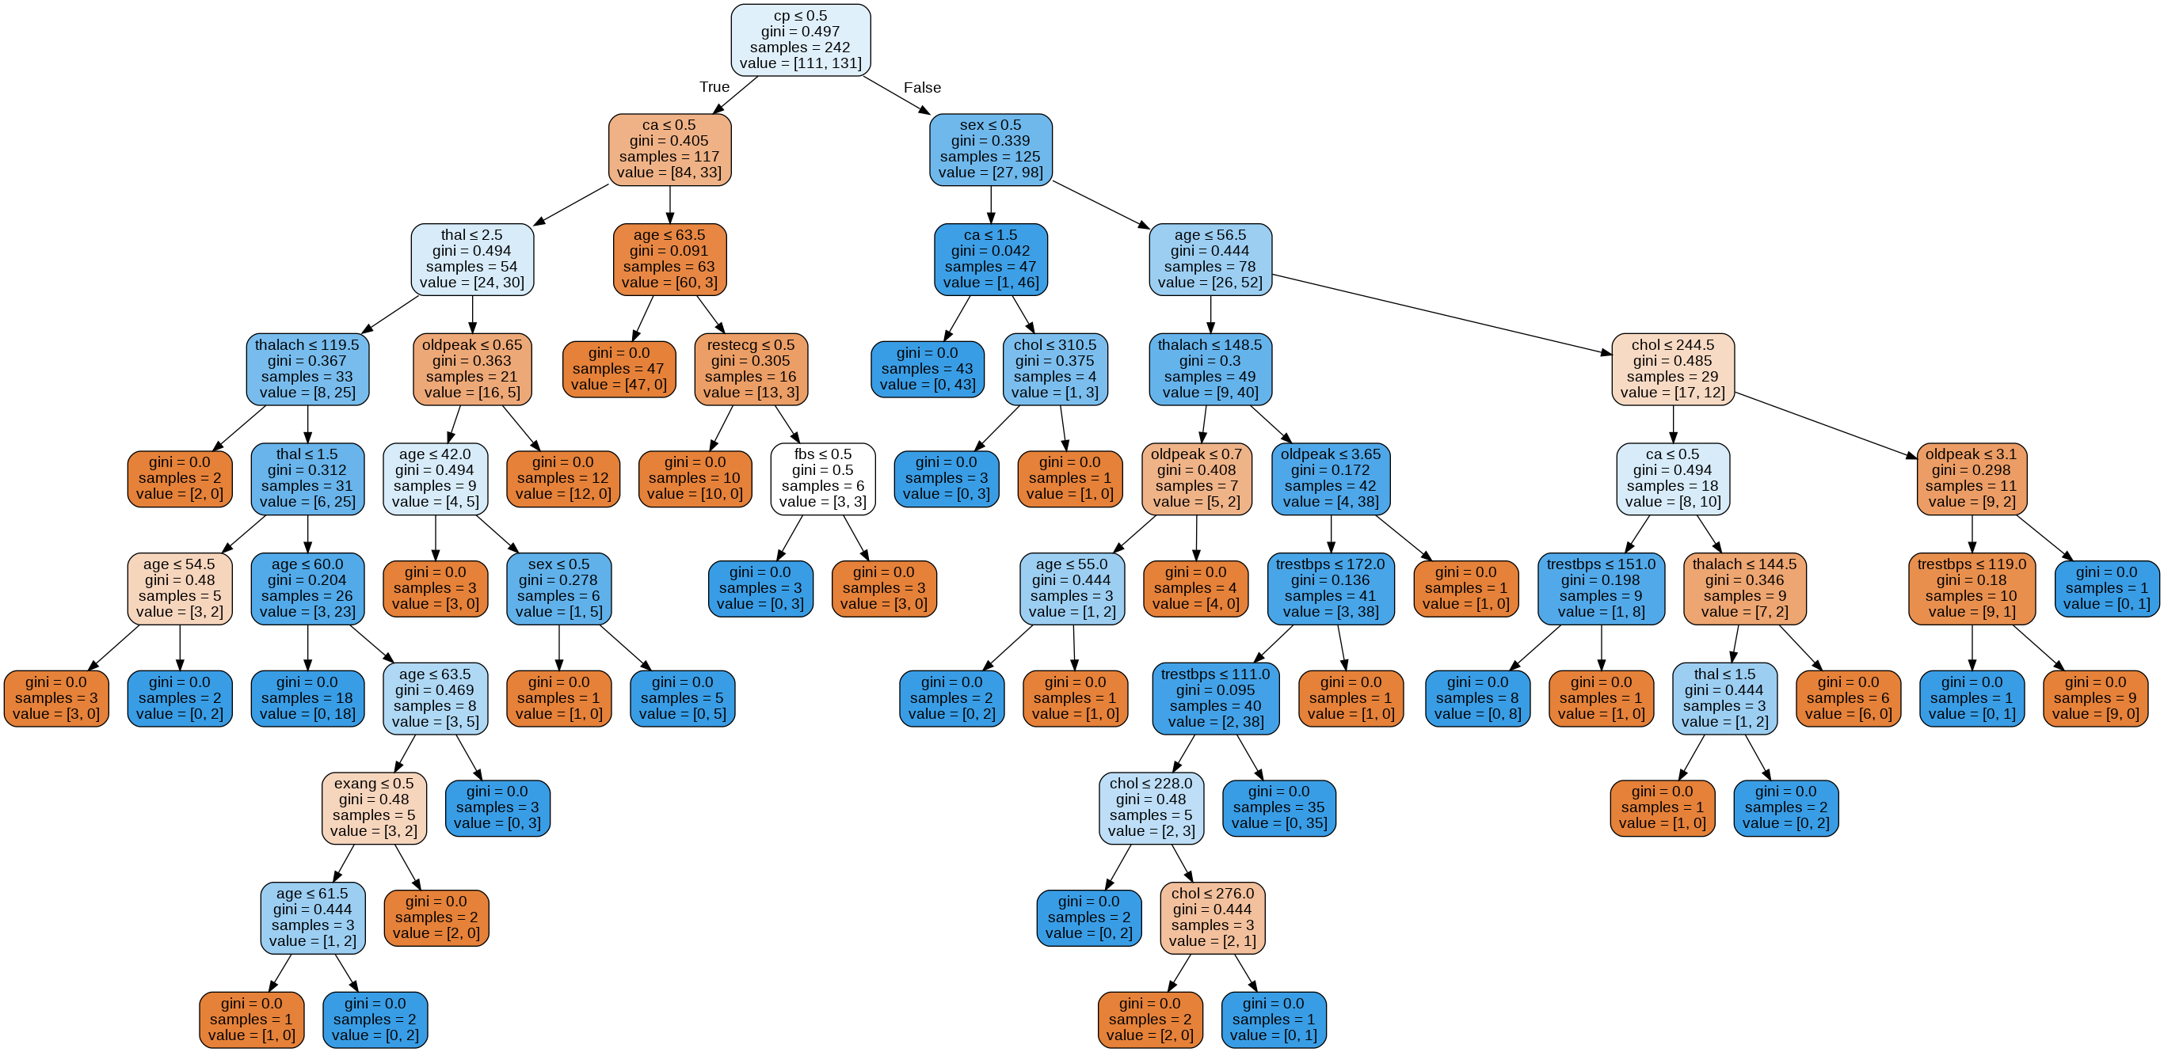
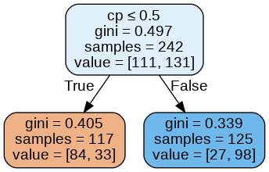

Slide 19
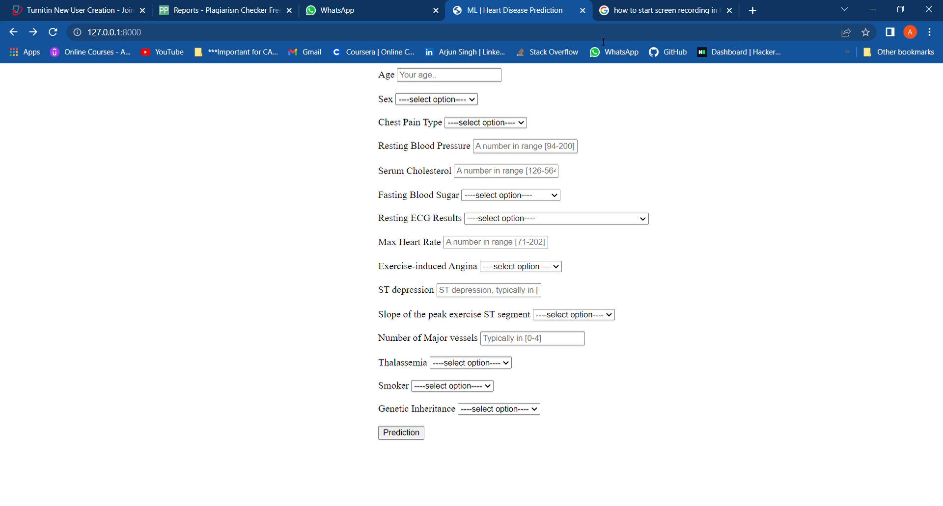
Working of the Project

Slide 20
Conclusion
Heart diseases are a major killer in India and throughout the world, application of promising technology like machine learning to the initial prediction of heart diseases will have a profound impact on society. The early prognosis of heart disease can aid in making decisions on lifestyle changes in high-risk patients and in turn reduce the complications, which can be a great milestone in the field of medicine.

Slide 21

THANK YOU

